Slide 1
Relational Databases

Slide 2
Why using databases?
A place to store data (typically not in your local computer)
Provides structure to the data (data types, constraints…)
Provides a mechanism for querying, creating, modifying and deleting data.

Slide 3
Relational Database Management Systems (RDBMS)
If you want to create and use relational databases, you need a piece of software. This software is the RDBMS.
MySQL, PostgreSQL, MariaDB, Oracle, IBM DB2… are all examples of RDBMS.
They all share the main principles, and the language used to query the data is almost (but not completely) identical.
MySQL is the most widely used one, and it’s open source.

Slide 4
SQL: Structured Query Language
Easy peasy language to interact with databases: select & filter information, join tables, create tables, insert/delete data…
To get started, what’s difficult is to set up the tools, create ‘connections’ to and from other tools, understand weird words like “schema”, “client”, “host” or “DBMS”.
Queries get difficult when the structure of the data itself gets complex, answers to business questions are not obvious
Most of the time, you need an intermediate level of SQL to get a job in the data world. However, you just need the knowledge to get the right data, not to set up & manage a database.

Slide 5
Relational databases save space & ensure data consistency
Employees_stores
emp_ID | First_name | Last_name | Store_id | Store_city | Store_type | Store_emp
1 | Vladimir | Popov | A | London | Showcase | 15
2 | Cinar | Horton | B | Norwich | Regular | 3
3 | Harry | Beltik | A | London | Showcase | 15
NON - RELATIONAL
Employees_stores
Employees
Stores
emp_id | store_id
1 | A
2 | B
3 | A
emp_id | First_name | Last_name
1 | Vladimir | Popov
2 | Cinar | Horton
3 | Harry | Beltik
Store_id | Store_city | Store_type | Store_emp
A | London | Showcase | 15
B | Norwich | Regular | 3
C | Bristol | Regular | 0
RELATIONAL
If an employee changes store, we just update this.
Only 1 row per store.
Easy to maintain and update.
We can have stores without employees.
Notes:
*minimize data redundancy

Slide 6
In relational databases, data is scattered across multiple tables. Good to avoid data redundancy, but not the easiest display for analysing and reporting.
The solution to this challenge is to create a data mart.
A data mart is a subset of the database with the information relevant for a specific department, a reporting task, a dashboard, etc.
A crucial part of creating a data mart is to join tables.

Slide 7

Creating a data mart (from relational to non-relational)
emp_id | store_id
1 | A
2 | B
3 | A
emp_id | First_name | Last_name
1 | Vladimir | Popov
2 | Cinar | Horton
3 | Harry | Beltik
Store_id | Store_city | Store_type | Store_emp
A | London | Showcase | 15
B | Norwich | Regular | 3
C | Bristol | Regular | 0
emp_ID | First_name | Last_name | Store_city
1 | Vladimir | Popov | London
2 | Cinar | Horton | Norwich

Slide 8
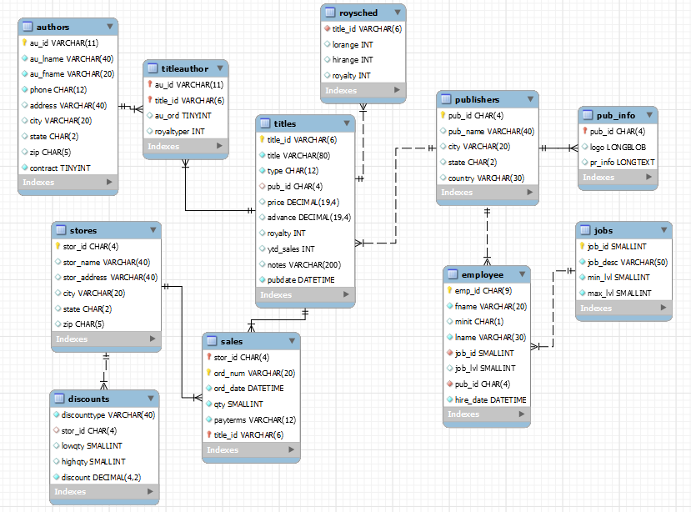
Data model
Also referred to as “Entity-Relationship Diagram”, “schema”...

Slide 9
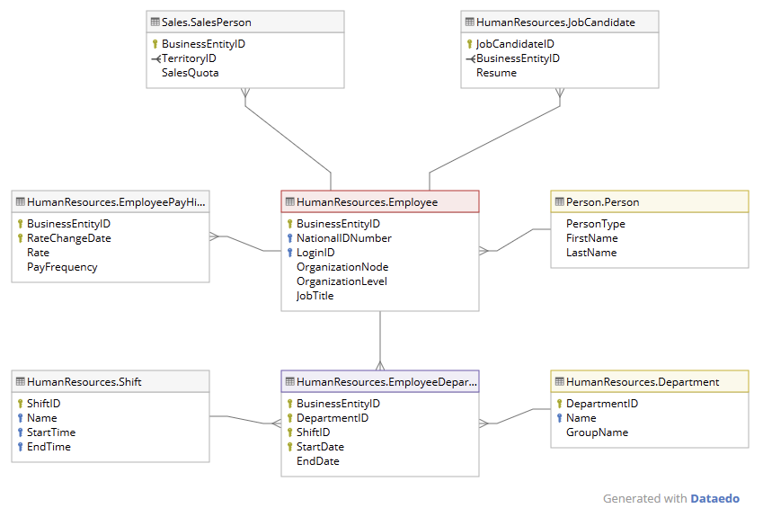
Data model
Also referred to as “Entity-Relationship Diagram”, “schema”...

Slide 10
Instances can have multiple schemas*
INSTANCE
In MySQL:
Instance = Connection
Schema = Database
*Different DBMS have slightly different terminologies/structures
SCHEMA 1
SCHEMA 2
SCHEMA 2
TABLE 1
TABLE 1
TABLE 1
TABLE 2
TABLE 2
TABLE 2
TABLE 3
TABLE 3
TABLE 3
TABLE 4
TABLE 4
TABLE 4
Notes:
A single computer can run multiple MySQL instances

Slide 11
SQL basic query functions
USE. Defines the schema to use in the session.
USE my_schema;
SELECT. Used to retrieve data.
SELECT column1, column2 FROM table;
SELECT * FROM table;
WHERE. Sets a condition for your select clause
SELECT * FROM table WHERE column1 > 10;
DISTINCT. Only select unique results
SELECT DISTINCT(column_1) FROM table;
LIMIT. Restricts the rows returned in the output (useful to test queries in big tables):
SELECT * FROM table LIMIT 10;
ORDER BY. Sorts results
SELECT * FROM table ORDER BY column1;
GROUP BY. Groups the data (needs an aggregation function):
SELECT column1, AVG(column2)
FROM table
GROUP BY column 1;
HAVING. Defines a condition for your select clause.
SELECT column1, AVG(column2)
FROM table
GROUP BY column 1
HAVING AVG(column2) >10;
COUNT, SUM, AVG, MAX, MIN...
https://www.sqltutorial.org/sql-cheat-sheet/

Slide 12
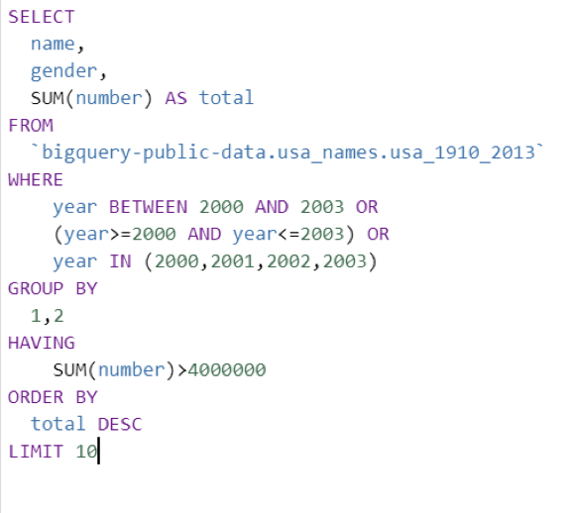
SQL Basic Components
SELECT existing fields or create derived fields (aggregated or not)
FROM which table to query
WHERE to filter for specified conditions
GROUP BY statement is often used with aggregate functions (COUNT, MAX, MIN, SUM, AVG) to group the result-set by one or more columns.
HAVING keyword specifies a search condition for an aggregate or a group
ORDER BY specified variables, if not specified by default it is ASC
LIMIT rows to display

Slide 13
MySQL data types
When creating a table, you’ll need to define the data types of each column. The most common ones are:
INT(size) - Integer with different sizes
FLOAT(size,d) - decimal numbers, with increasing ‘accuracy’ & ‘size’
VARCHAR(size) - A string with variable length
DATETIME - Date & time in YYYY-MM-DD hh:mm:ss format. There are other options in case you just need the time, the year, etc.
There are many more data types, designed to optimize the space & fit every need, but you will mostly use these ones. Full docs here: https://dev.mysql.com/doc/refman/8.0/en/data-types.html

Slide 14
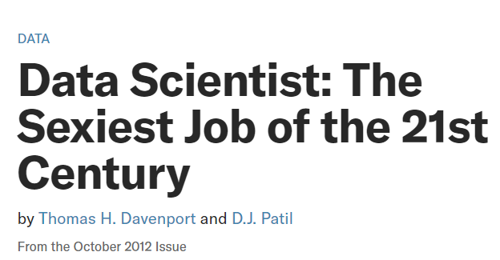

SELECT * FROM t1;

